Slide 1
Deployment of Mobile EEG Technology in an Art Museum Setting: Evaluation of Signal Quality and Usability
Salvatore Arancio Febbo

Slide 2
Introduction

Slide 3
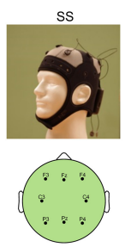
Project background and context
- EEG data collection using 8 electrodes
- Sampling rate of 500 samples per second
- Total duration of 20 seconds for each recording
- Total number of attributes: 8 * 500 * 20 = 80,000
- Total number of records: 125
- Each record classified with emotion, portrait, beautiful labels

Slide 4

Project objective
Project Objective: Extracting features and creating a classification model
Extract relevant features from EEG signals
Develop a classification model to identify individual situations
Utilize machine learning techniques for classification
Classify individuals into three categories: Emotion, Portrait, Beautiful
Enable identification of individual situations from EEG data

Slide 5
Pre-processing

Slide 6
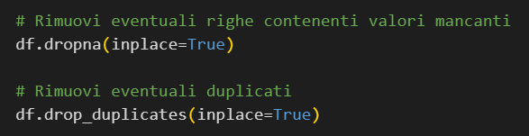
Data Cleaning: Removing Missing Values and Duplicates
No duplicates were present in the dataset
No missing values were found in the dataset

Slide 7
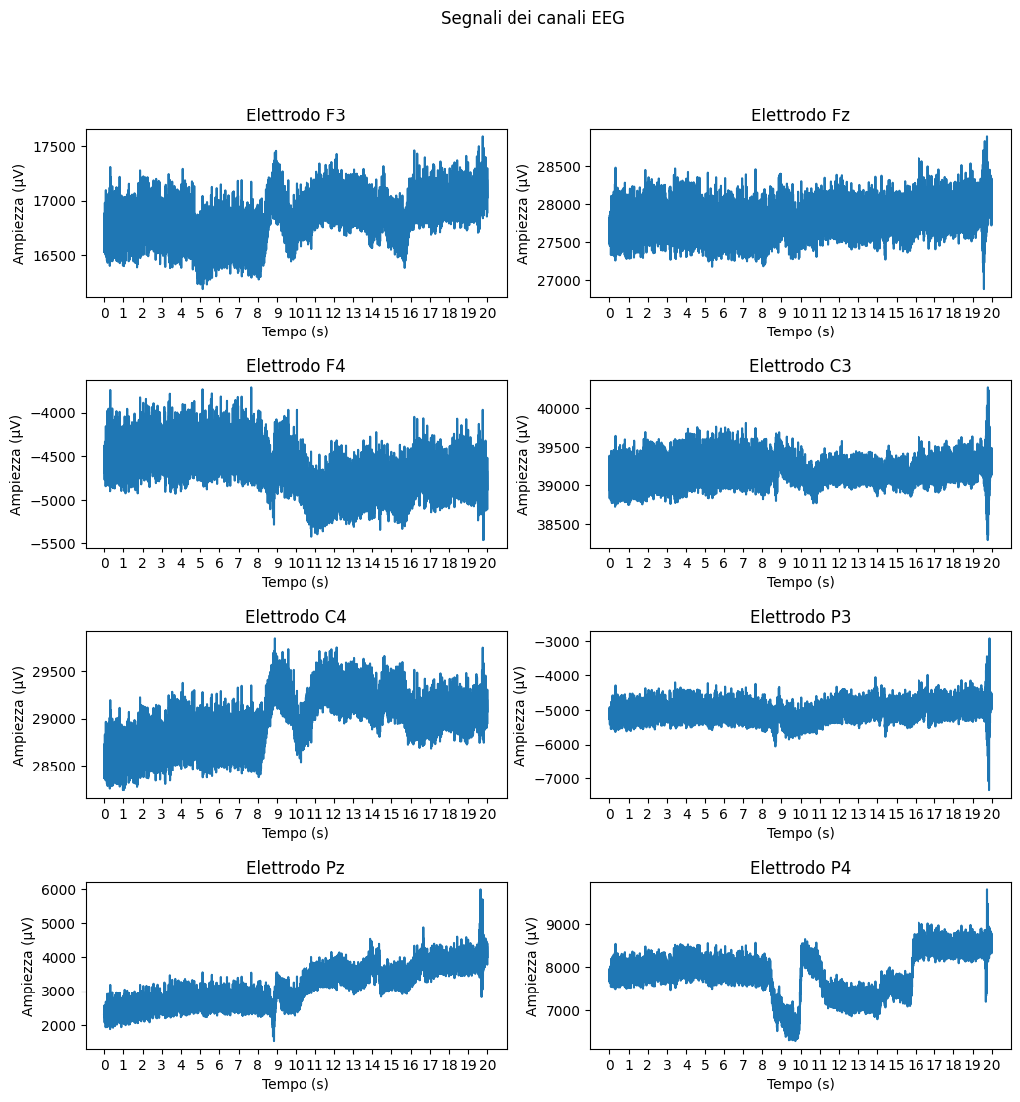
EEG Signals from 8 Electrodes - Record Visualization

Slide 8
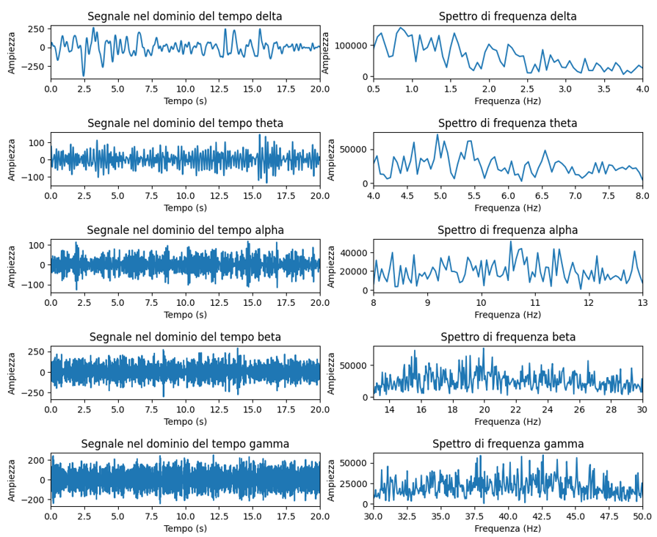
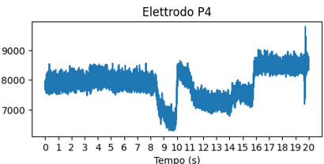


EEG Signal Analysis and Fourier Transform

Slide 9
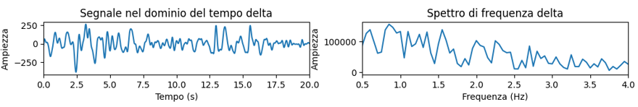
Extracting features for each brain wave
10 Features Extracted:
- Power: Calculated power of the brain wave
- Mean: Average value of the brain wave
- Standard Deviation: Measure of the dispersion of the brain wave
- Energy: Calculated energy of the brain wave
- Power Entropy: Entropy calculated on the power distribution
- Energy Entropy: Entropy calculated on the energy distribution
- Minimum Peak: Minimum value reached by the brain wave
- Maximum Peak: Maximum value reached by the brain wave
- Kurtosis: Measure of the shape of the distribution of the brain wave
- Shannon Entropy: Shannon entropy calculated on the power distribution

Slide 10
Total Features for Analysis
- Calculation Formula:
- Number of Electrodes: 8
- Number of Brain Waves: 5
- Number of Features per Brain Wave: 10
- Target Feature: 1
- Total Features:
- Number of Electrodes × Number of Brain Waves × Number of Features per Brain Wave + Target Feature
- 8 × 5 × 10 + 1 = 401

Slide 11
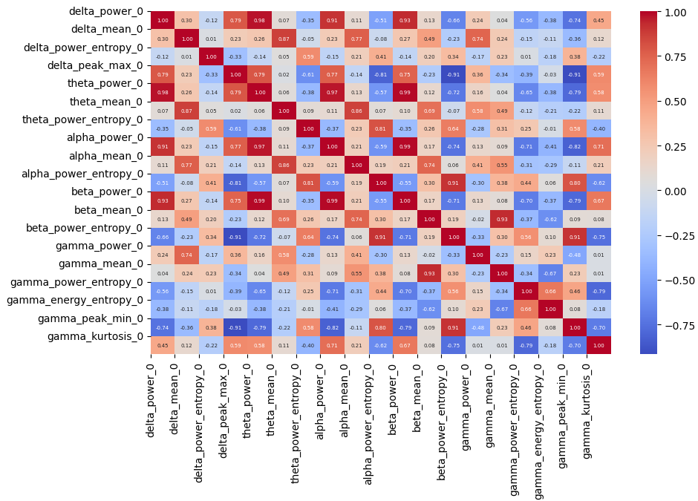
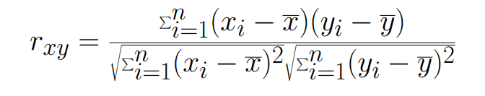
Feature Reduction using Pearson's Correlation Coefficient
Pearson's correlation coefficient measures the linear relationship between two continuous variables.
It ranges from -1 to 1.

Slide 12
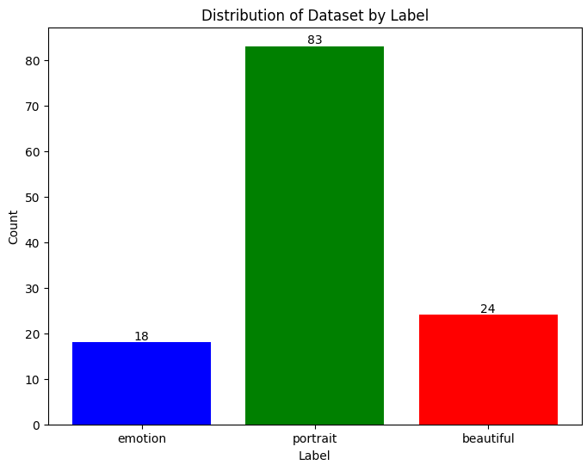
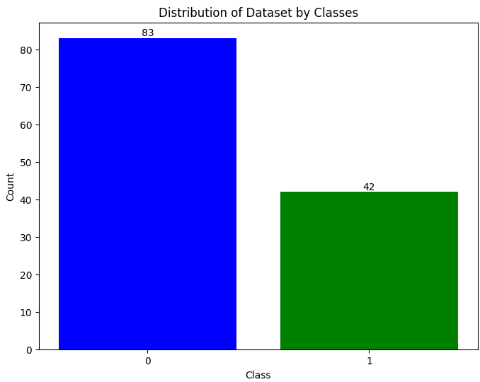
Distribution of Dataset by Label
Class 0: portait
Class 1: emotion, beautiful

Slide 13
Classification Models

Slide 14
Used Classifiers
Classification algorithm based on the proximity between data points
Random Forest
Powerful and versatile ensemble of decision trees
Decision Tree
Machine learning algorithm that makes decisions based on data splitting conditions
Gradient Boosting
Machine learning method that constructs a predictive model by iteratively adding decision trees
Variation of Random Forest that introduces randomness in tree training to improve diversity and robustness
KNeighbors
Extra Trees
SVC
Classification model that finds a hyperplane to separate data of different classes
Logistic Regression
Classification algorithm that models the probability of belonging to a class using a logistic function

Slide 15
Model Evaluation and Optimization Pipeline: K-Fold Stratified Cross-Validation and Grid Search
- For each classifier, I applied hyperparameter tuning using GridSearchCV.
- To address the issue of class imbalance in the dataset, I integrated the stratified k-fold technique.
- By using the combination of GridSearchCV, stratified k-fold, and pipeline, I optimized the performance of each classifier and achieved better results.

Slide 16
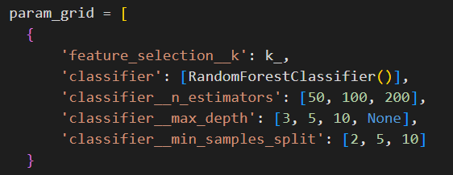
Example of Stratified K-Fold, Pipeline, and Grid Search

Slide 17
Datasets and training
Phase 1.
Parameter Testing with Grid Search
- Utilized entire dataset
- Tested different parameters using Grid Search and Cross Validation
- Objective: Find optimal parameters for maximum model performance based on f1-score
Phase 2.
Using parameters
- Dataset split: 80% for training, 20% for testing
- Cross Validation performed on 80% training data
- Evaluate model performance on 20% testing set

Slide 18
Classification Using 20-Second Signal Records

Slide 19
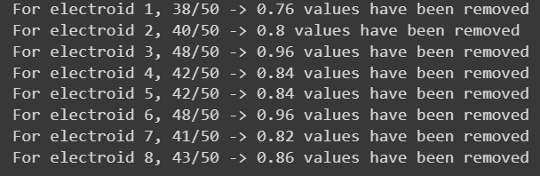
Eliminated Features due to High Correlation
To address this, we set a threshold, such as 0.80, and eliminate features with an absolute correlation value above this threshold
From 401 to 59 features

Slide 20
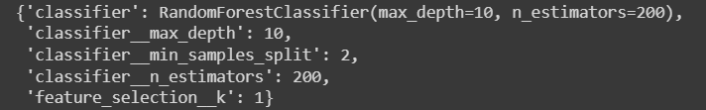
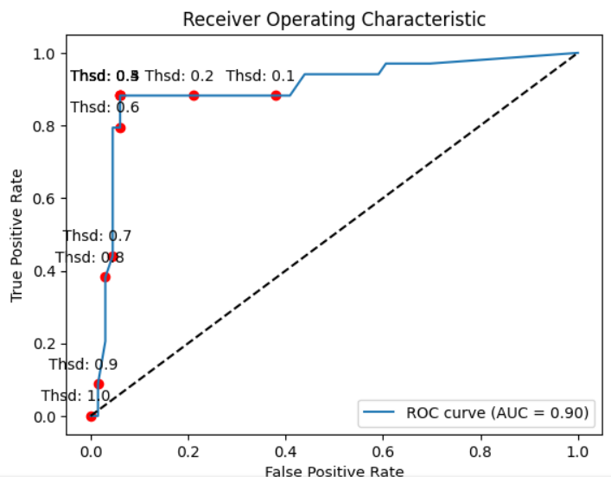
Random Forest
Best parameter based on f1-score:
Best threshold of class 1 based on f1-score : 0.596

Slide 21
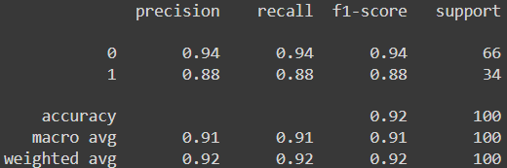
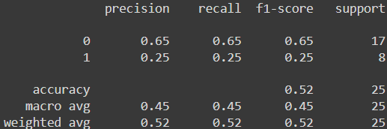
Random Forest
Train Report:
Confusion matrix (train):
Test Report:
Confusion matrix (test):
62
4
11
6
4
30
6
2

Slide 22
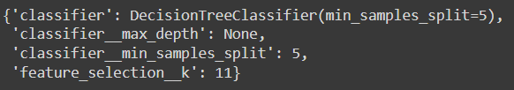
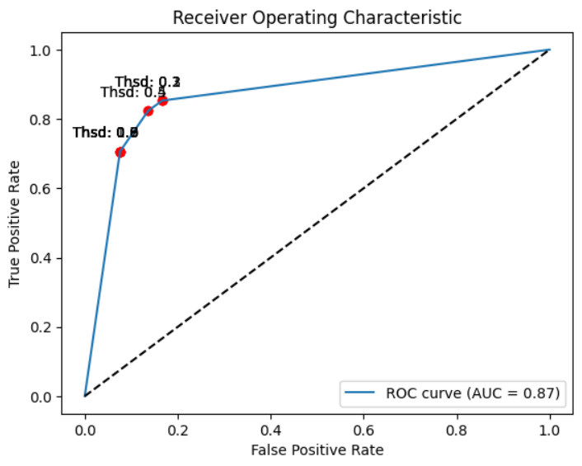
Decision Tree
Best parameter based on f1-score:
Best threshold of class 1 based on f1-score : 0.50

Slide 23
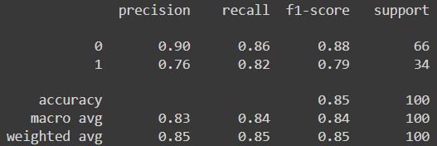
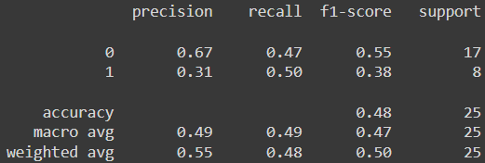
Decision Tree
Train Report:
Confusion matrix (train):
Test Report:
Confusion matrix (test):
57
9
8
9
6
28
4
4

Slide 24
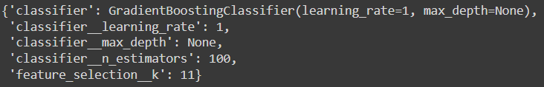
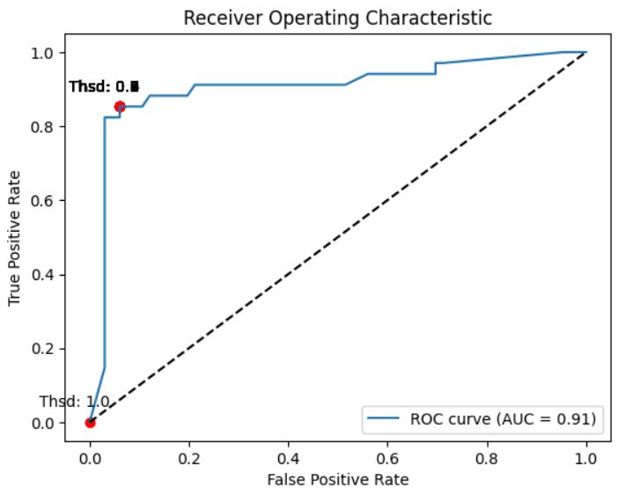
Gradient Boosting
Best parameter based on f1-score:
Best threshold of class 1 based on f1-score : 0.9999999652453043

Slide 25
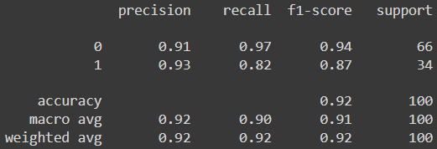
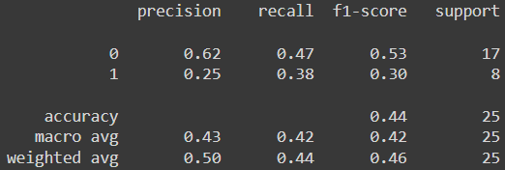
Gradient Boosting
Train Report:
Confusion matrix (train):
Test Report:
Confusion matrix (test):
64
2
8
9
6
28
5
3

Slide 26
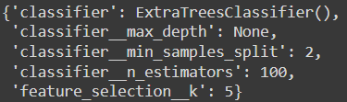

Extra Trees
Best parameter based on f1-score:
Best threshold of class 1 based on f1-score : 0.5

Slide 27
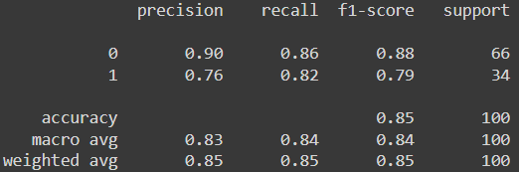
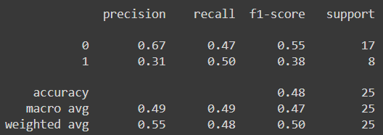
Extra Trees
Train Report:
Confusion matrix (train):
Test Report:
Confusion matrix (test):
57
9
8
9
6
28
4
4

Slide 28
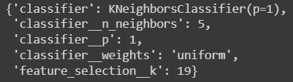
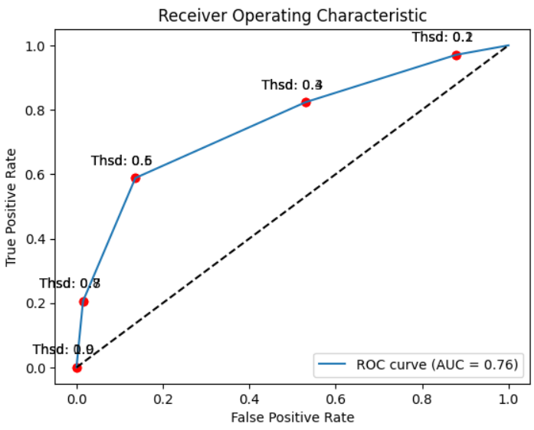
KNeighbors
Best parameter based on f1-score:
Best threshold of class 1 based on f1-score : 0.6

Slide 29
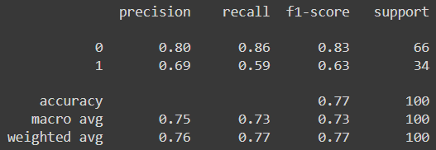
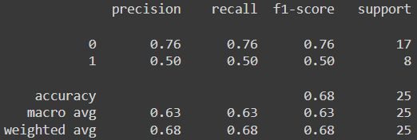
KNeighbors
Train Report:
Confusion matrix (train):
Test Report:
Confusion matrix (test):
57
9
13
4
14
20
4
4

Slide 30

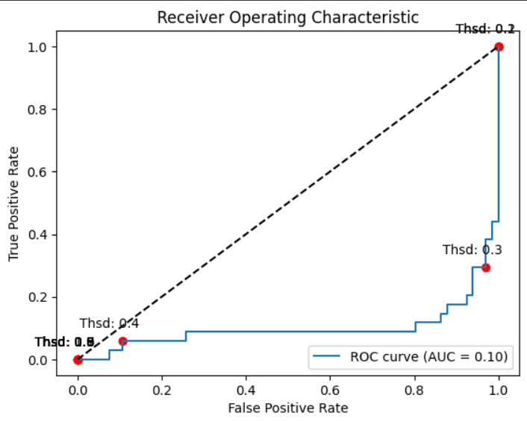
SVC
Best parameter based on f1-score:
Best threshold of class 1 based on f1-score : 0.46998930508540626

Slide 31
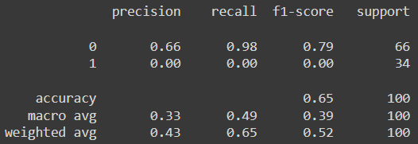
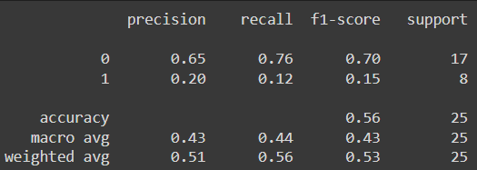
SVC
Train Report:
Confusion matrix (train):
Test Report:
Confusion matrix (test):
65
1
13
4
34
0
7
1

Slide 32
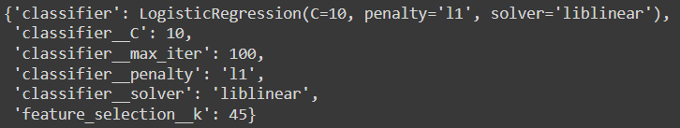
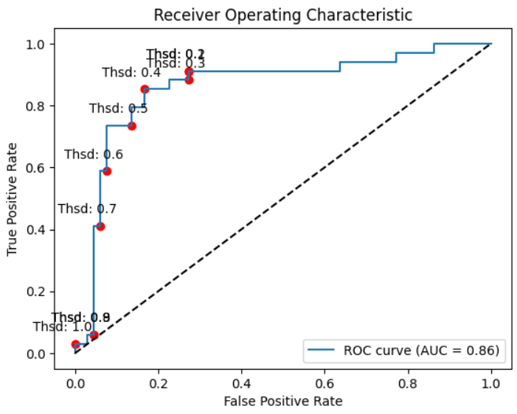
Logistic Regession
Best parameter based on f1-score:
Best threshold of class 1 based on f1-score : 0.4149873863140597

Slide 33
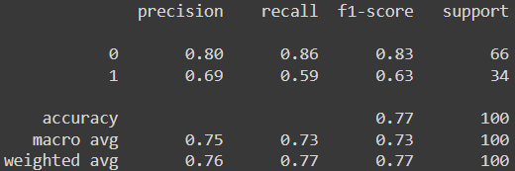
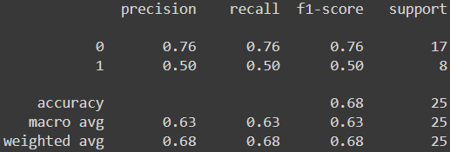
Linear Regression
Train Report:
Confusion matrix (train):
Test Report:
Confusion matrix (test):
57
9
13
4
14
20
4
4

Slide 34
Are they all good or are they all bad classifiers? And can each one be used by assigning it a certain weight?

Slide 35
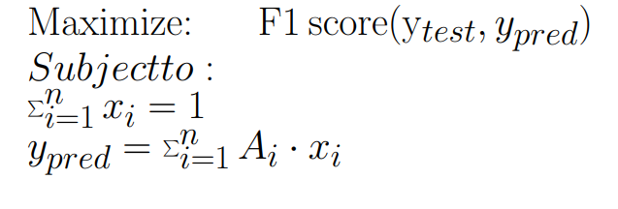
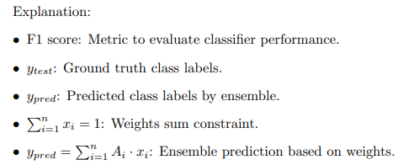
Ensemble of Classifiers using Linear Programming
The matrix A contains, for each classifier, the probability that each record belongs to class 1. In this case as well, the threshold has been manipulated to determine the most suitable threshold value for classification.

Slide 36
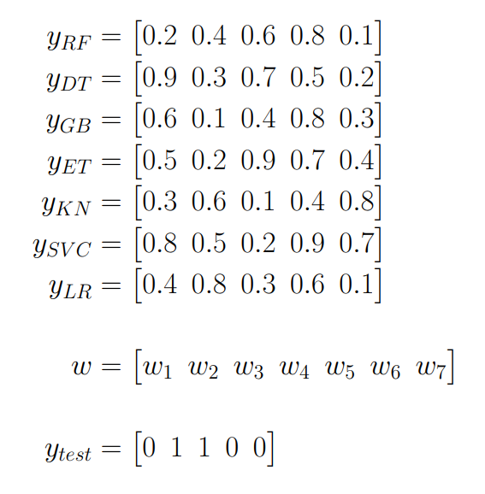
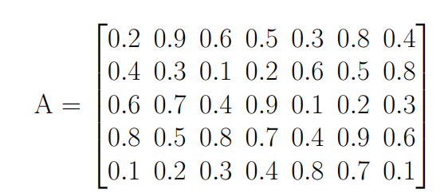

How to assign weight to classifiers

Slide 37
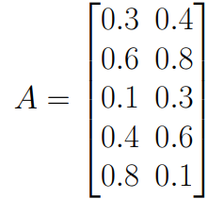
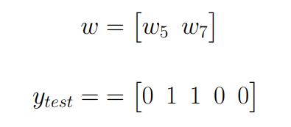
Overfitting problem
If overfitted models are used, it is not possible to extract interesting information, then the overfitted classifiers are discarded

Slide 38
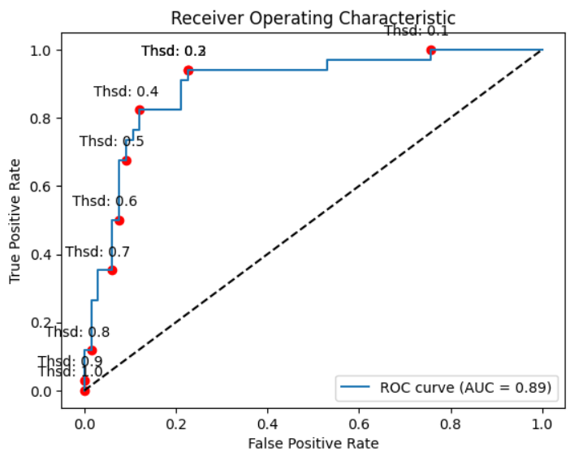
Ensemble Result
Best threshold of class 1 based on f1-score : 0.300316868307016

Slide 39
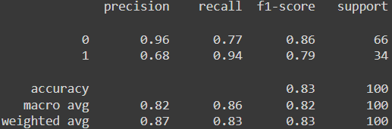
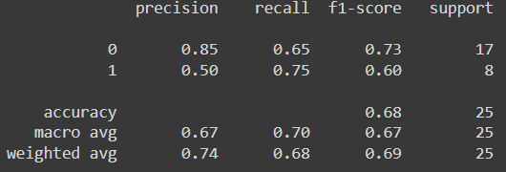
Ensemble Result
Train Report:
Confusion matrix (train):
Test Report:
Confusion matrix (test):
51
15
11
6
2
32
2
6

Slide 40
Classification Using 5-Second Signal Records

Slide 41
Splitting 20-Second Signal Records into Four 5-Second Signal Records
Electorod 1
Electorod 2
Electorod 3
Electorod 4
Electorod 5
Electorod 6
Electorod 7
Electorod 8
Firs 20-second record
Electorod 1
Electorod 2
Electorod 3
Electorod 4
Electorod 5
Electorod 6
Electorod 7
Electorod 8
A 5-second record
A 5-second record
A 5-second record
A 5-second record
From 125 to 500 tuples

Slide 42
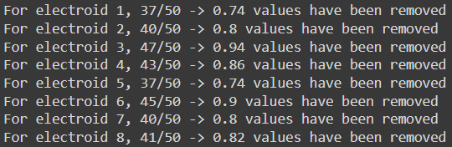
Eliminated Features due to High Correlation
To address this, we set a threshold, such as 0.80, and eliminate features with an absolute correlation value above this threshold
From 401 to 71 features

Slide 43
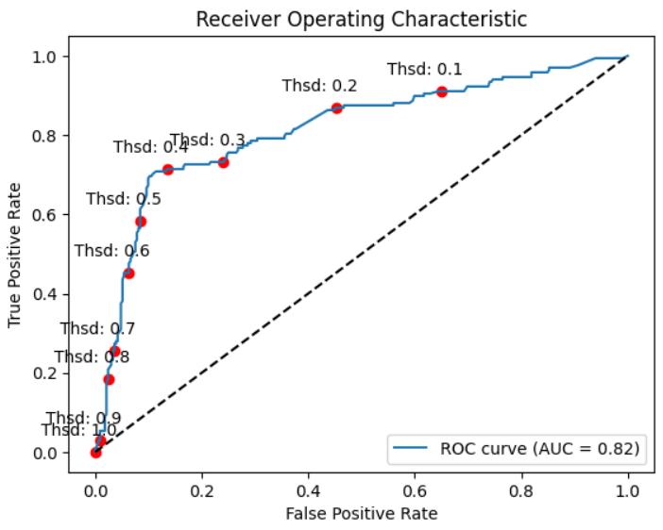
Random Forest
Best parameter based on f1-score:
Best threshold of class 1 based on f1-score : 0.4474214908073708

Slide 44
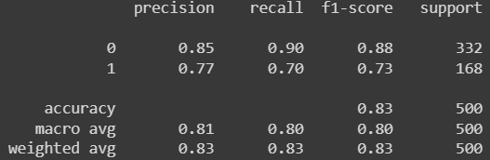

Random Forest
Train Report:
Confusion matrix (train):
Test Report:
Confusion matrix (test):
298
34
61
7
51
117
14
18

Slide 45

Decision Tree
Best parameter based on f1-score:
Best threshold of class 1 based on f1-score : 0.3333333333333333

Slide 46


Decision Tree
Train Report:
Confusion matrix (train):
Test Report:
Confusion matrix (test):
284
48
58
10
40
128
12
20

Slide 47

Gradient Boosting
Best parameter based on f1-score:
Best threshold of class 1 based on f1-score : 0.003292721826168578

Slide 48


Gradient Boosting
Train Report:
Confusion matrix (train):
Test Report:
Confusion matrix (test):
298
34
58
10
40
128
13
19

Slide 49

Extra Tress
Best parameter based on f1-score:
Best threshold of class 1 based on f1-score : 0.39

Slide 50


Extra trees
Train Report:
Confusion matrix (train):
Test Report:
Confusion matrix (test):
296
36
67
1
33
135
12
20

Slide 51

KNeighbors
Best parameter based on f1-score:
Best threshold of class 1 based on f1-score : 0.4

Slide 52


KNeighbors
Train Report:
Confusion matrix (train):
Test Report:
Confusion matrix (test):
214
118
60
8
55
113
23
9

Slide 53

SVC
Best parameter based on f1-score:
Best threshold of class 1 based on f1-score : 0.31336439851268416

Slide 54


SVC
Train Report:
Confusion matrix (train):
Test Report:
Confusion matrix (test):
271
61
60
8
46
122
21
11

Slide 55

Logistic Regession
Best parameter based on f1-score:
Best threshold of class 1 based on f1-score : 0.4

Slide 56


Linear Regression
Train Report:
Confusion matrix (train):
Test Report:
Confusion matrix (test):
214
118
60
8
55
113
23
9

Slide 57
Ensemble Result
Best threshold of class 1 based on f1-score : 0.4920470233689264

Slide 58


Ensemble Result
Train Report:
Confusion matrix (train):
Test Report:
Confusion matrix (test):
325
7
66
2
26
142
9
23

Slide 59
Can we use fewer classifiers to get the same result?

Slide 60
Classifier combinations
Size of the micro ensemble (k) | Number of micro sets
1 | 7
2 | 21
3 | 35
4 | 35
5 | 21
6 | 7
7 | 1
Again each combination was handled as a linear programming problem judged on the basis of the f1_score

Slide 61

Combination of 2 is the winner
Best threshold of class 1 based on f1-score : 0.3910286544487744
- RandomForest
- GradientBoosting

Slide 62


Combination of 2 is the winner
Train Report:
Confusion matrix (train):
Test Report:
Confusion matrix (test):
314
18
62
6
14
154
7
25

Slide 63
Conclusions and Future Perspectives
Despite the limited amount of data, we have achieved promising results, demonstrating the effectiveness of our approach.
The obtained results indicate that even with a small dataset, we were able to achieve satisfactory performance.
With a larger volume of data, we anticipate further improvements in classification accuracy and robustness.
Future work involves collecting additional data to enhance the model's performance and explore its capabilities in diverse scenarios.

Slide 64
Thank you
Salvatore Arancio Febbo
s.aranciofebbo@studenti.unipi.it

